Slide 1
Mobile Application Development
Lecture 17

Slide 2
Targetting multiple platforms in Ionic
There are certain scenarios where we might need to run some code on a particular device.
For e.g, I only want this code to run if the app is running on Android.
Ionic provides us way to check which device is it currently and we can use that to run the platform specific code.
Notes:
First of all, we need to understand what Parent, Child, and Sibling components are.

Slide 3
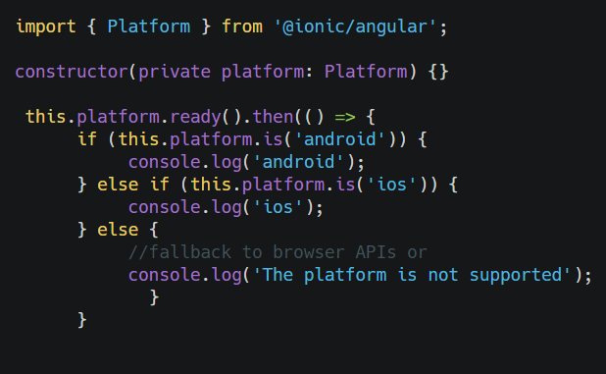
Targetting multiple platforms in Ionic
Ionic provide Platform Service which we can use to check which platform we’re currently on.
This helps us write platform specific code.
https://ionicframework.com/docs/angular/platform
Notes:
First of all, we need to understand what Parent, Child, and Sibling components are.

Slide 4
Handling Issues/Crashes in Production
Suppose your customer tells you that the mobile app you created crashes on certain scenarios.
Often the hard problem is figuring out what caused the failure. Why did app crash for you ? It’s running perfectly for me.
There is where Firebase Crashlytics (previously Fabric) comes in.
Notes:
First of all, we need to understand what Parent, Child, and Sibling components are.

Slide 5
Crashlytics
provides Real-time alerts.
Provides crash analytics. Tells you which error caused how many crashes and on which devices.
Very easy to setup with Ionic. Just add a cordova plugin, few lines of code and your crashlytics are up. https://ionicframework.com/docs/native/firebase-crashlytics
Notes:
First of all, we need to understand what Parent, Child, and Sibling components are.

